Slide 1
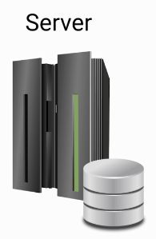


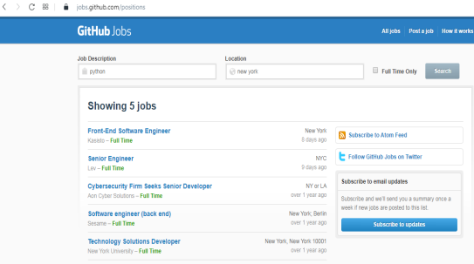

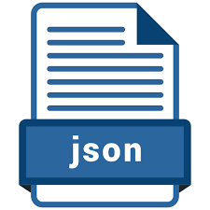
Web Server Vs. API Server
Github Job Application
Client
Program to generate HTML
Search Program
Program to query the database
API Program

Slide 2

How to use an API?
https://jobs.github.com/positions?description=python&location=new+york
https://jobs.github.com/positions.json?description=python&location=new+york

Slide 3
Before Spring Boot
https://www.udemy.com/course/introduction-to-apis-rest-api-graphql-soap-web-services-grpc/learn/lecture/18670220#overview

